Slide 1
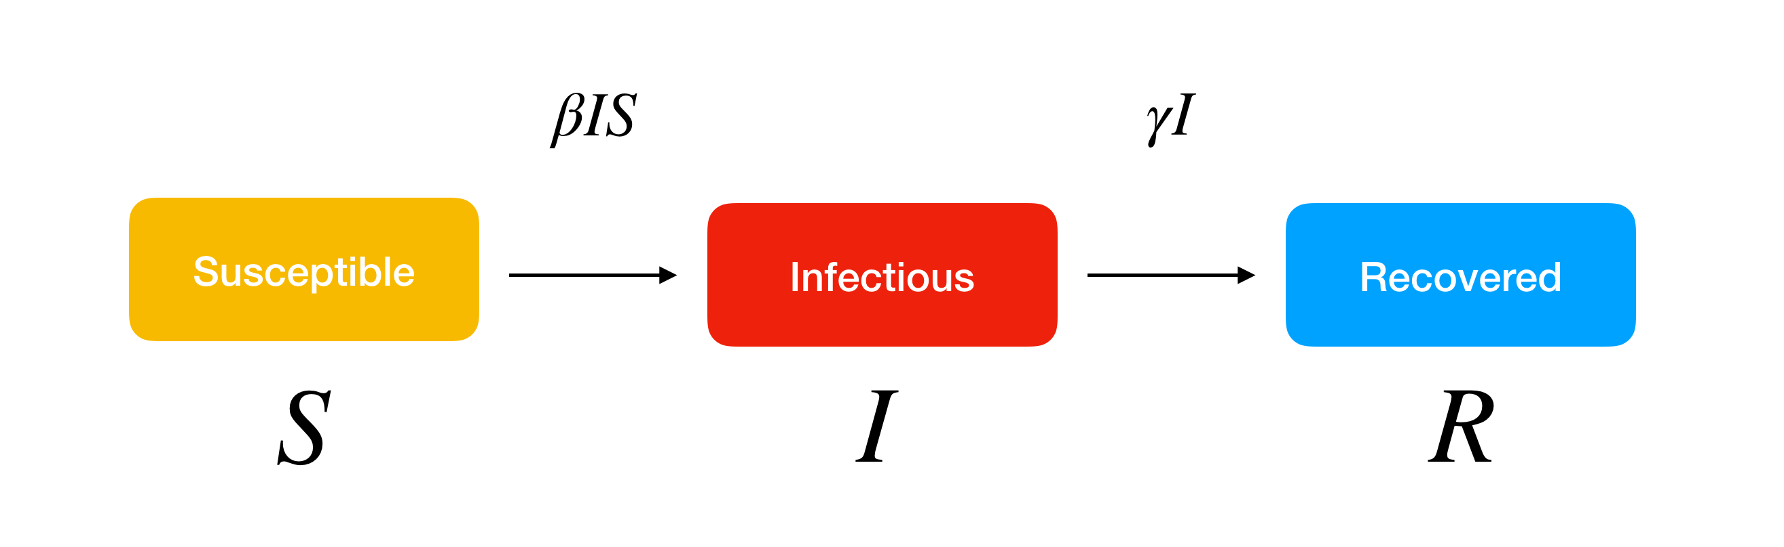
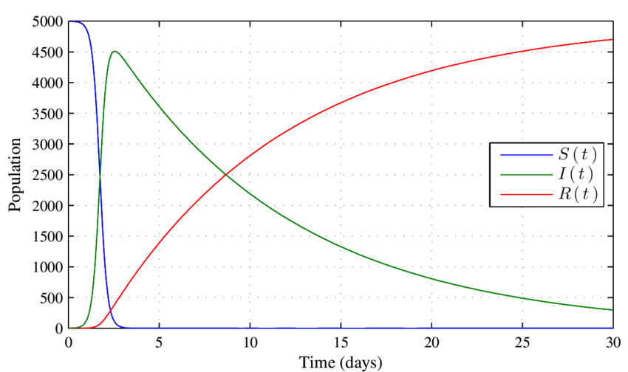
Modeling of COVID 19
Professor : Robert Ness
Team Members: Derrie Susan Varghese
Sai Srikanth Lakkimsetty
Sayan Biswas
Sneha Agarwal

Slide 2
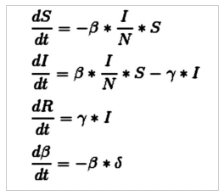
ODEs for SIR Model
Differential equations are used in SIR to show the change in each category per unit time.
Total population here is given by N. N = S + I + R
The ODEs given in the image below were used in our SIR model.
beta : Transmission Rate gamma : Recovery Rate delta : Rate at which beta changes

Slide 3
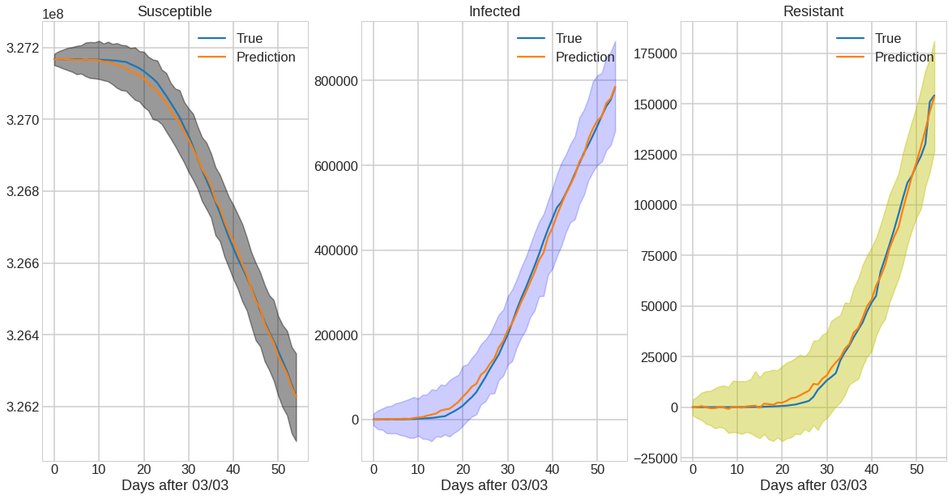
Parameters Learnt(Using MCMC inference algorithm)
beta = 0.51, delta = 0.05, gamma = 0.01

Slide 4
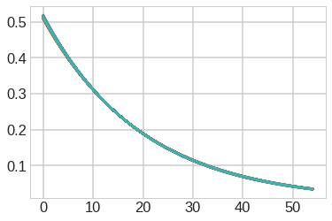
Variation of Transmission Rate(beta) with time

Slide 5
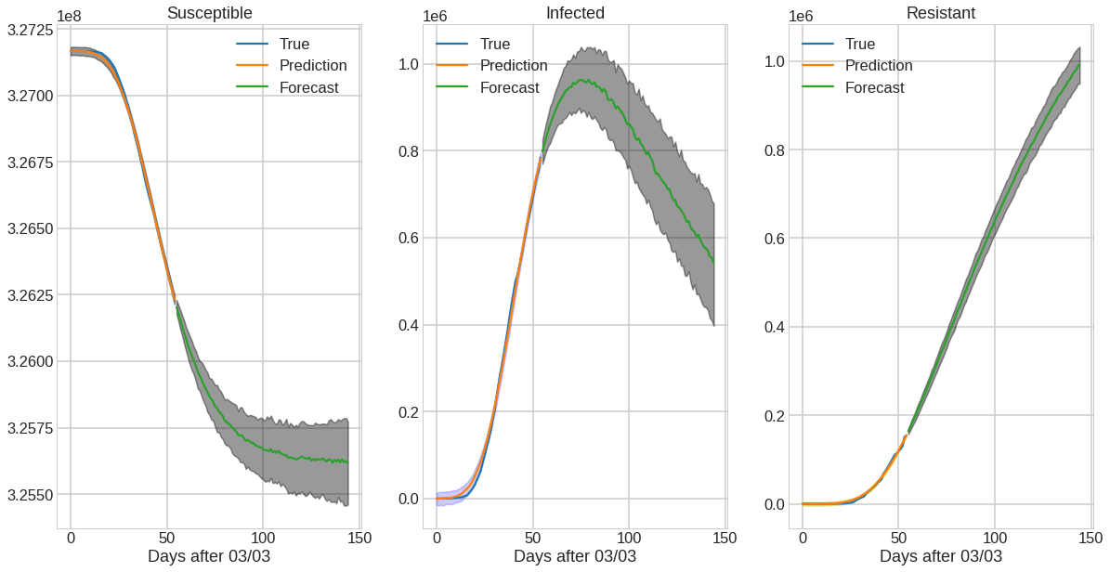
Prediction for next 90 days using parameters learnt

Slide 6
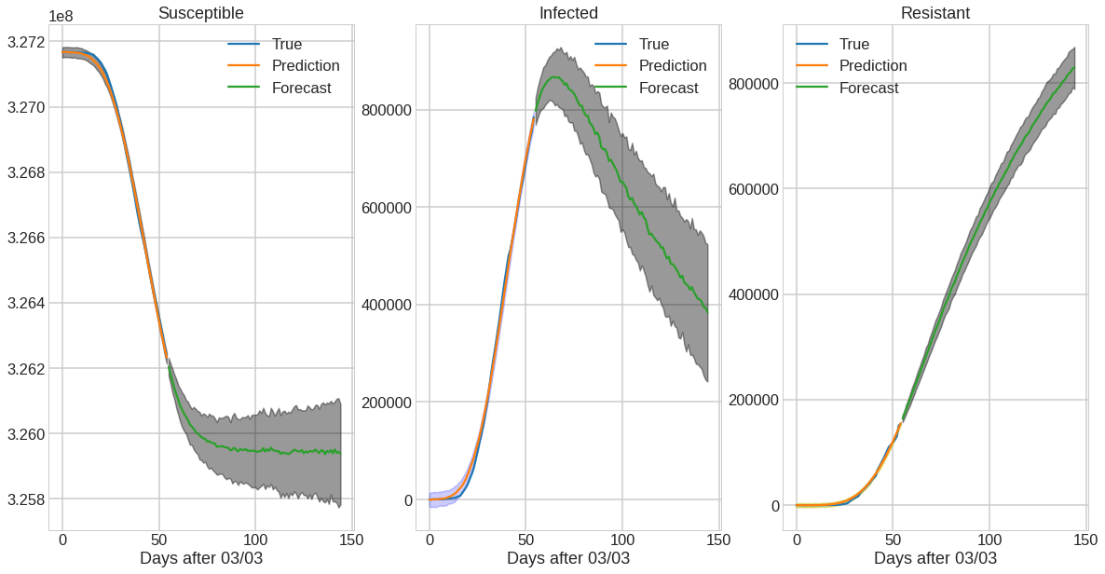
Prediction for next 90 days with intervention
Intervening on delta = 0.1 at present time

Slide 7
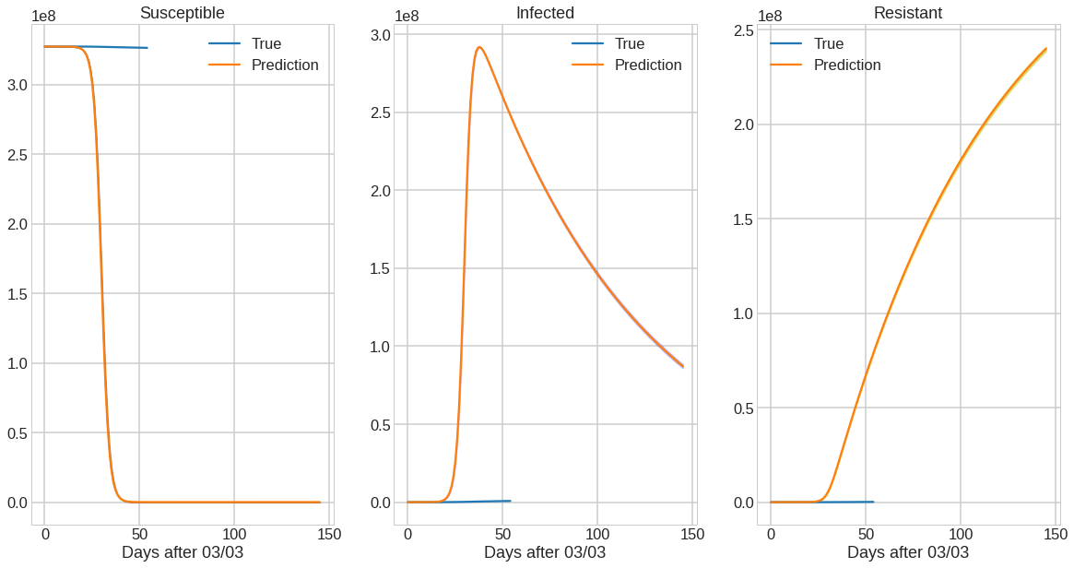
Had we not taken any measures how would the country look like?
Intervening on delta = 0 at present time

Slide 8
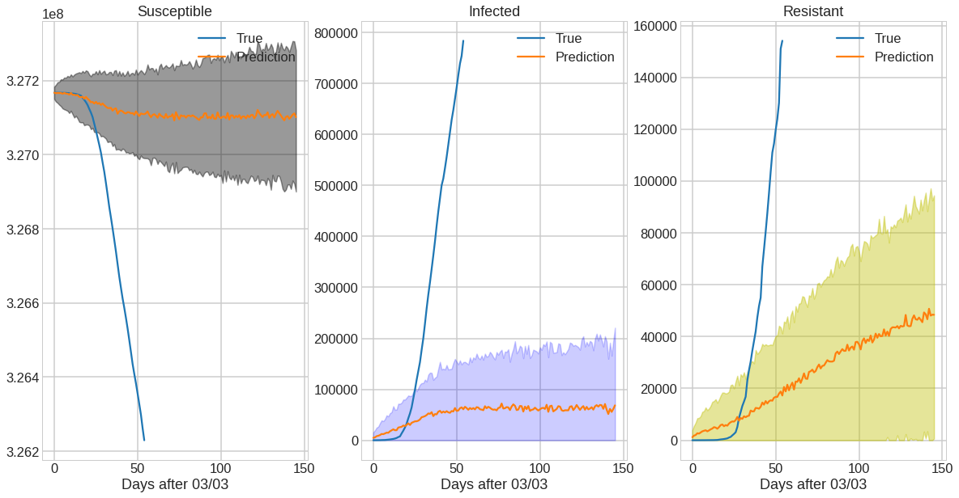
Had we taken measures how would the country look like?
Intervening on delta = 0.075 at present time

